Slide 1
Week-3
Session-2
Understanding Economics and How It Affects Business

Slide 2
Topics to be Covered
The major branches of economics
Resource development
Key Economic Indicators
The Invisible Hand Theory
Free market Capitalism, foundations of capitalism, Socialism and Communism
The Trend Towards Mixed Economies
Competition within Free Markets
Demand and its determinants
Supply and its determinants
Equilibrium, shortage and surplus

Slide 3
The Trend Towards Mixed Economies
Free-market economies exist when the market largely determines what goods and services get produced, who gets them, and how the economy grows.
Command economies exist when the government largely decides what goods and services will be produced, who gets them, and how the economy will grow.
Mixed economies have economic systems in which some allocation of resources is made by the market and some by the government. Most countries don’t have a name for such a system. If free-market mechanisms allocate most resources, the leaders call their system capitalism. If the government allocates most resources, the leaders call it socialism.

Slide 4
Competition within Free Markets
Monopoly: The single seller sells a product for which there are no close substitutes. In the United States, laws prohibit the creation of monopolies.
Oligopoly: A degree of competition in which just a few sellers dominate the market.
Perfect competition: It exists when there are many sellers in a market, and none is large enough to dictate the price of a product.
Monopolistic competition: It exists when there are many sellers producing very similar products that buyers nevertheless perceive as different,

Slide 5
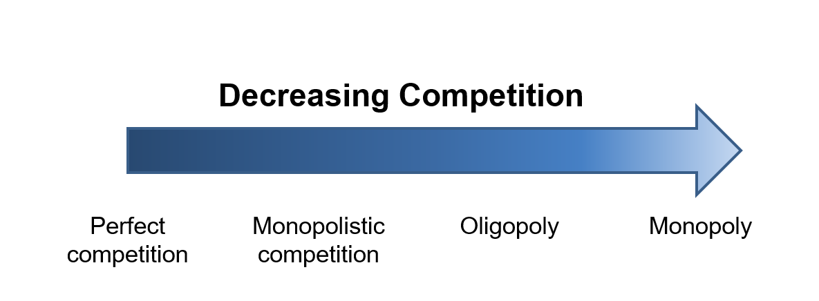

Slide 6
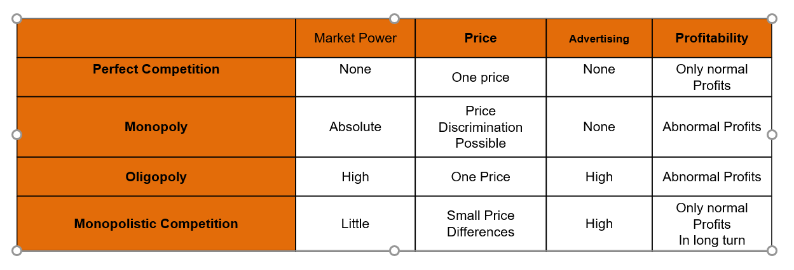
Implications of Theory for Behaviour of firms

Slide 7
Demand
Demand: The willingness and ability of buyers to purchase different quantities of a good at different prices during a specific period of time.
Law of Demand: The law of demand states that the price of a good and the quantity demanded of the good are inversely related, ceteris paribus.
Change in quantity demanded occurs when there is a change in price.
Change in demand occurs when a factor other than price affects the quantity demanded.

Slide 8
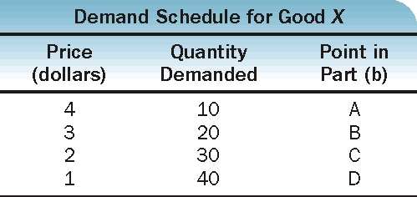
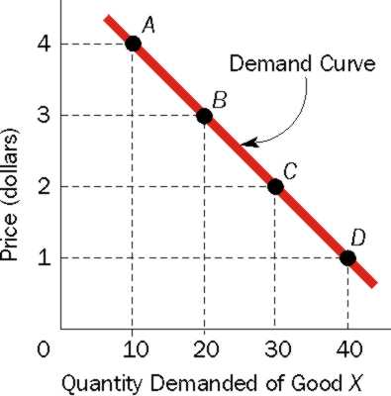
Demand (continued)
(a)
(b)

Slide 9
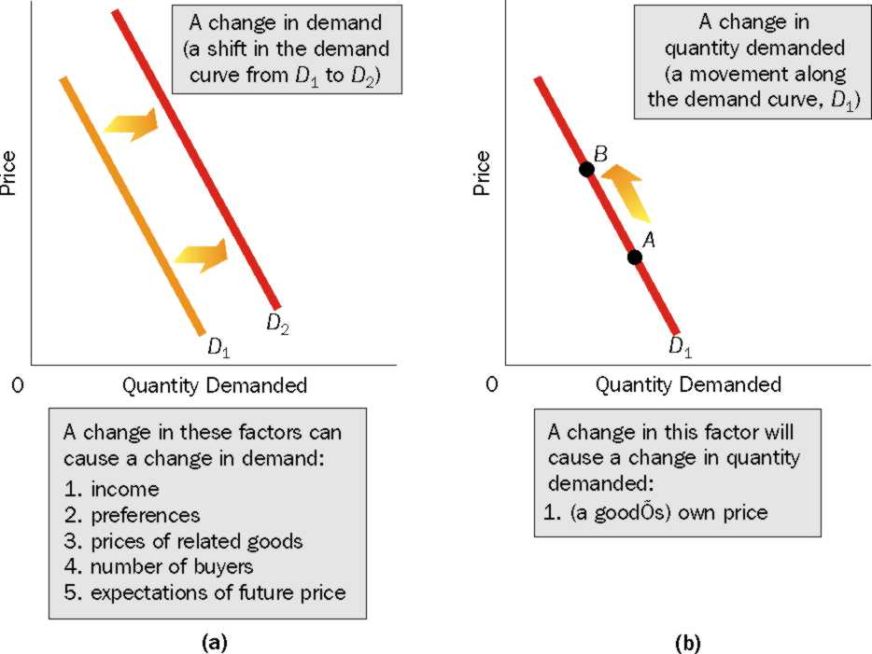
Demand (continued)

Slide 10
Supply
Supply: The willingness and ability of sellers to produce and offer to sell different quantities of a good at different prices during a specific period of time.
Law of Supply: The law of supply states that the price of a good and the quantity supplied of the good are directly related, ceteris paribus
Change in quantity supplied occurs when there is a change in the market price of the product
Change in supply is caused by a determinant other than the price

Slide 11
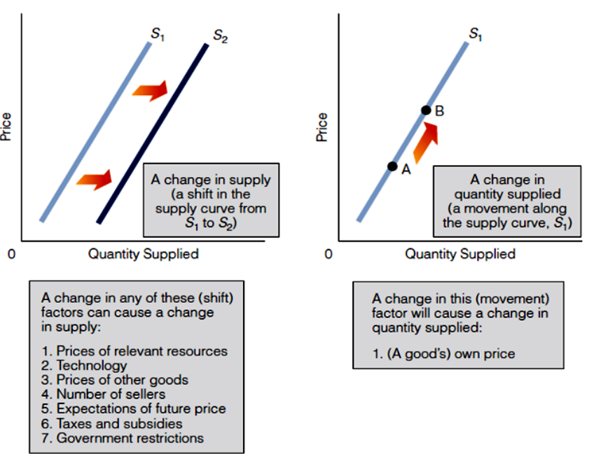
Supply (continued)

Slide 12
References
Arnold, R. A. (2014) Macroeconomics (11th ed.). South-Western.
Mankiw, N.G. (2018) Principles of Microeconomics (8th ed.). Cengage Learning.
Nickels, W. G., McHugh, J. M. & McHugh, S. (2014) Understanding Business (11th ed.). McGraw-Hill.

